Slide 1
CO2 emissions
Team 1

Slide 2
Overview and purpose of project
Causes of CO2 emissions
Purpose of the project
Analyze factors that contribute to CO2 emissions
Comparing the CO2 emissions per country
Predict the impact of CO2 emissions

Slide 3
CO2 emissions from
2018:
2020:
Include statistics…
(speaking points) Examples which showcase the impact on the environment
Past 30 years
Increase of CO2 emissions over the past 30 years
Impact on climate change which led to an increase in the number of annual natural disasters

Slide 4
Current CO2 emissions 2010-2022
(speaking points) Although all countries agree on decreasing the CO2 emissions to reduce the impact on climate change, they do not agree on the countries who are responsible for the CO2 emissions. Developed countries argue that they are making efforts to reduce CO2 emissions and developing countries state that they are in fact survival emissions.
On the other hand, developing countries argue that the developed countries have already caused pollution and the
Upon analysis, China ranks highest in CO2 emissions, 11 billion tons.
Followed by the United States and India.

Slide 5
Current CO2 emissions 2010-2022

Slide 6
Historic CO2 emissions
It is insufficient to only look at the current CO2 emissions,
From the chart, we can tell that the USA ranked highest on the CO2 emitting countries, followed by the European Union.
From the historic data from 1960-1980, we can see that the United States and the countries in the European Union have historically emitted more CO2 emissions than China.
In the 20th Century, the United States has emitted around 20 billion tons of CO2 emissions.

Slide 7
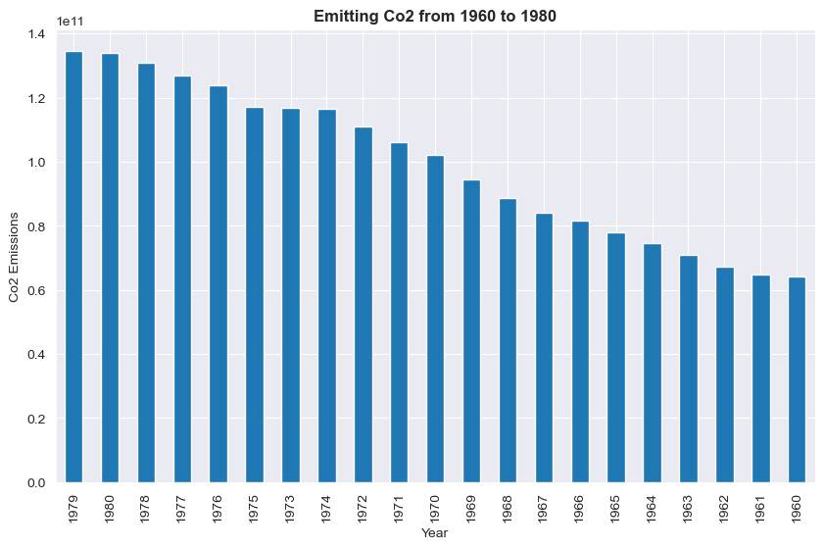
Cumulative CO2 emissions from 1960-1980

Slide 8
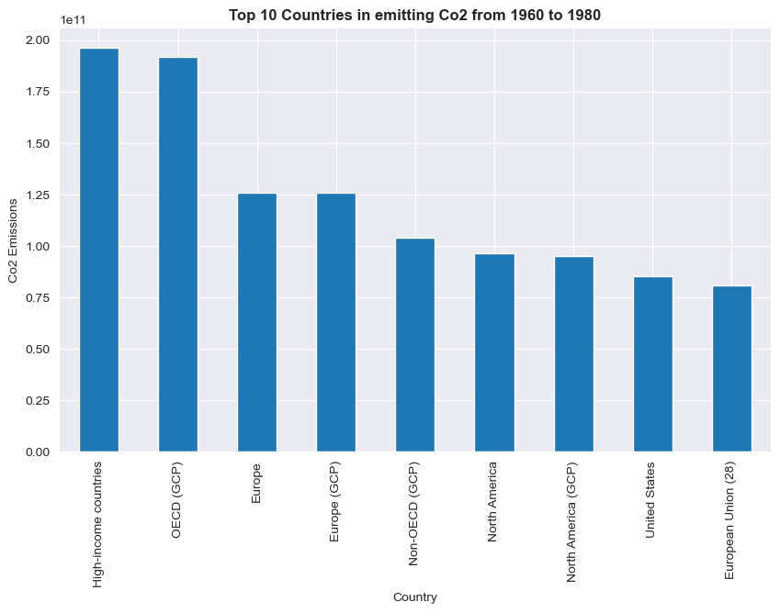
Top 10 countries is CO2 emissions Historic data from 1960-1980

Slide 9
CO2 emissions per Capita 2010-2022
The average human is responsible for 5 tons of CO2 emissions/year.
The numbers varies based on individuals from different countries. For example, the population in the oil producing countries have higher CO2 emissions.
Qatar is the top country which has the highest CO2 emissions. They emit around 37 tons/year.
Wealth is one of the strongest indicators of carbon footprint.
(SP) as individuals accumulate wealth, they gain access to modern technologies.
The wealthiest half of the countries are responsible for 86% of global emissions. The bottom half only contribute to 14% of the global emissions.

Slide 10
Impact of CO2 emissions
It is the countries that contribute to the problem that stand to lose the most from rapid climate change.
Developing countries will be hit the hardest leading to conflict over resources, food insecurity, an increase natural disasters and climate refugee movements.

Slide 11
Proposed solutions
The richest countries have access to the resources, highly educated workforce and technology to develop low cost, low carbon solutions and spread them around the world.
If we don’t want developing countries to become as fossil fuel dependent as developed countries are, then low carbon technologies must be cheap and accessible.
Climate change is a global problem and no country alone can fix it. Everyone needs to do the best they can and right now we are not doing it.

Slide 12
Ethical considerations

Slide 13
Conclusion

Slide 14
Resources
Hannah Ritchie, Pablo Rosado and Max Roser (2023) - “CO₂ and Greenhouse Gas Emissions” Published online at OurWorldInData.org. Retrieved from: 'https://ourworldindata.org/co2-and-greenhouse-gas-emissions' [Online Resource]
Kurzgesagt – In a Nutshell. (2020, June 21). Who Is Responsible For Climate Change? – Who Needs To Fix It? [Video]. Youtube. https://www.youtube.com/watch?v=ipVxxxqwBQw

